Slide 1
Pillars of OOP
Inheritance
Polymorphism
Encapsulation
Abstraction

Slide 2

Inheritance

Slide 3
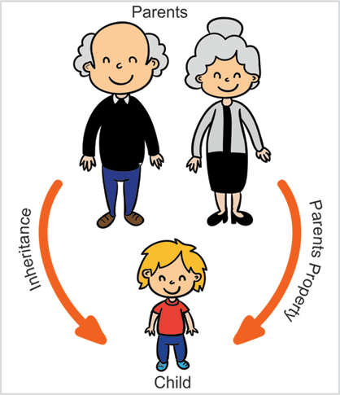
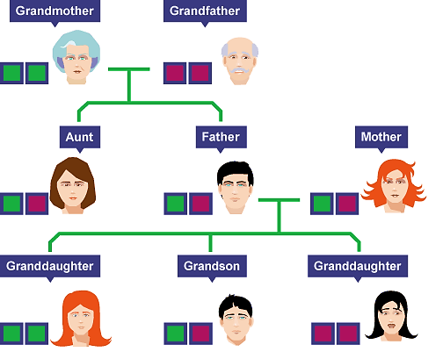
Inheritance

Slide 4
Inheritance
class Doctor
class Footballer
class Businessman
Attributes:
Age, Height, Weight
Methods:
Talk()
Walk()
Eat()
Diagnose()
Attributes:
Age, Height, Weight
Methods:
Talk()
Walk()
Eat()
Playfootball()
Attributes:
Age, Height, Weight
Methods:
Talk()
Walk()
Eat()
Runbusiness()
All of the classes have common attributes (Age, Height, Weight) and methods (Walk, Talk, Eat).
However, they have some special skills like Diagnose, Playfootball and Runbusiness.
In each of the classes, you would be copying the same code for Walk, Talk and Eat for each character.

Slide 5
Inheritance
The mechanism of a class to derive properties and characteristics from another class is called Inheritance.
It is the most important feature of Object Oriented Programming.
Inheritance is the process, by which class can acquire(reuse) the properties and methods of another class.
Base Class: The class whose properties are inherited by sub class is called Base Class/Super class/Parent class.
Derived Class: The class that inherits properties from another class is called Sub class/Derived Class/Child class.
Inheritance is implemented using super class and sub class relationship in object-oriented languages.
Base Class
Derived Class

Slide 6
Inheritance
class Person is called Base class
class Person
Attributes:
Age, Height, Weight
Methods:
Talk() , Walk(), Eat()
class Doctor
class Footballer
class Businessman
Methods:
Diagnose()
Methods:
Playfootball()
Methods:
Runbusiness()
These classes are called Derived class

Slide 7
Inheritance
class Vehicle
Attributes:
Engine_no, color
Methods:
apply_breaks()
class Car
class Bus
class Truck
Attributes:
Private_vehicle
Attributes:
Public_vehicle
Attributes:
Goods_vehicle

Slide 8
Inheritance: Advantages
Promotes reusability
When an existing code is reused, it leads to less development and maintenance costs.
It is used to generate more dominant objects.
Avoids duplicity and data redundancy.
Inheritance makes the sub classes follow a standard interface.
Base Class
Derived Class

Slide 9
Implementing Inheritance
Subclass-Superclass Relationship

Slide 10
Introduction
Inheritance is the process, by which a class can acquire(reuse) the properties and methods of another class.
The mechanism of deriving a new class from an old class is called inheritance.
The new class is called derived class and old class is called base class.
The derived class may have all the features of the base class and the programmer can add new features to the derived class.
Inheritance is also known as “IS-A relationship” between parent and child classes.
For Example :
Car IS A Vehicle
Bike IS A Vehicle
EngineeringCollege IS A College
MedicalCollege IS A College
MCACollege IS A College

Slide 11
Inheritance Example
class Vehicle
Attributes:
Engineno, color
Methods:
applybreaks()
class Car
class Bus
class Truck
Attributes:
privatevehicle
Attributes:
publicvehicle
Attributes:
goodsvehicle

Slide 12
How to implement Inheritance in java
To inherit a class, you simply incorporate the definition of one class into another by using the extends keyword.
Syntax:
class subclass-name extends superclass-name {
// body of class…
}

Slide 13
Implementing Inheritance in java
class A
{
//SuperClass or ParentClass or BaseClass
}
Class A
Base Class
the keyword “extends” is used to create a subclass of A
class B extends A
{
//SubClass or ChildClass or DerivedClass
}
Class B
Derived Class

Slide 14
Implementing Inheritance in java
class Person
{
String name;
long contact;
}
class Employee extends Person
{
int empID;
String designation;
}
Class Customer extends Person
{
int customerID;
int invoiceNo;
}
Person
name:String Contact:long
Employee
empID:int Designation:String
Customer
customerID:int InvoiceNo:int

Slide 15
Implementing Inheritance in java
class Person
{
String name;
long contact;
public void dispContact()
{ System.out.println(“num=”+contact);
}
}
class Employee extends Person
{
int empID;
String designation;
}
Class Customer extends Person
{
int customerID;
int invoiceNo;
}
Person
name:String Contact:long
dispContact():void
Employee
empID:int Designation:String
Customer
customerID:int InvoiceNo:int

Slide 16
Property of Inheritance

Slide 17
Property of Inheritance
A class member that has been declared as private will remain private to its class. It is not
accessible by any code outside its class, including subclasses.
Base class A can’t access attributes and methods of Derived Class B
Class A
Base Class
Derived Class B can’t access private members of Base class A
Class B
Derived Class
Derived Class B can access attributes and methods of Base class A

Slide 18
Inheritance by Example

Slide 19
Example1: InheritanceDemo1
A
#i:int ~j:int
showij():void
B
~k:int
showk():void add():void

Slide 20
Example1: InheritanceDemo.java
class A{
protected int i;
int j;
void showij(){
System.out.println("i="+i+" j="+j);
}
}
class B extends A{ //inheritance
int k;
void showk(){
System.out.println("k="+k);
}
void add(){ System.out.println("i+j+k="+(i+j+k));
}
}
class InheritanceDemo{
public static void main(String[] args)
{
A superObjA= new A();
superObjA.i=10;
superObjA.j=20;
B subObjB= new B();
subObjB.k=30;
superObjA.showij();
subObjB.showk();
subObjB.add();
}
}
Output
i=10 j=20
k=30
i+j+k=30

Slide 21
Types of Inheritance in Java
1. Single Inheritance
2. Hierarchical Inheritance
3. Multilevel Inheritance
A
A
A
B
B
C
B
C
4. Multiple Inheritance
5. Hybrid Inheritance
A
B
A
Note: Multiple and Hybrid Inheritance is not supported in Java with the Class Inheritance, we can still use those Inheritance with Interface which we will learn in later part of the Unit
B
C
C
D

Slide 22
Single Inheritance
A
B

Slide 23
Single Inheritance: InheritanceDemo.java
class A{
protected int i;
int j;
void showij(){
System.out.println("i="+i+" j="+j);
}
}
class B extends A{ //inheritance
int k;
void showk(){
System.out.println("k="+k);
}
void add(){ System.out.println("i+j+k="+(i+j+k));
}
}
class InheritanceDemo{
public static void main(String[] args)
{
A superObjA= new A();
superObjA.i=10;
superObjA.j=20;
B subObjB= new B();
subObjB.i=100
subObjB.j=100;
subObjB.k=30;
superObjA.showij();
subObjB.showk();
subObjB.add();
}
}
A
B
Output
i=10 j=20
k=30
i+j+k=230

Slide 24
Hierarchical Inheritance
A
B
C

Slide 25
class A{
protected int i;
int j;
void showij(){
System.out.println("inside class A:i="+i+" j="+j);
}
}
class B extends A{
int k;
void showk(){ System.out.println("inside class B:k="+k);
}
void add_ijk(){ System.out.println(i+"+"+j+"+"+ k+"="+(i+j+k));
}}
class C extends A{
int m;
void showm(){
System.out.println("inside class C:k="+m);
}
void add_ijm(){
System.out.println(i+"+"+j+ "+"+m+"="+(i+j+m));
}
}
A
B
C
InheritanceLevel.java

Slide 26
class InheritanceLevel{
public static void main(String[] args) {
A superObjA= new A();
superObjA.i=10;
superObjA.j=20;
superObjA.showij();
B subObjB= new B();
subObjB.i=100;
subObjB.j=200;
subObjB.k=300;
subObjB.showk();
subObjB.add_ijk();
C subObjC= new C();
subObjC.i=1000;
subObjC.j=2000;;
subObjC.m=3000;
subObjC.showm();
subObjC.add_ijm();
}
}
InheritanceLevel.java
A
B
C
Output
inside class A:i=10 j=20
inside class B:k=300
100+200+300=600
inside class C:k=3000
1000+2000+3000=6000

Slide 27
Multilevel Inheritance
A
B
C

Slide 28
class A{
protected int i;
int j;
void showij(){
System.out.println("inside class A:i="+i+" j="+j);
}
}
class B extends A{
int k;
void showk(){ System.out.println("inside class B:k="+k);
}
void add_ijk(){ System.out.println(i+"+"+j+"+"+ k+"="+(i+j+k));
}}
class C extends B{
int m;
void showm(){
System.out.println("inside class C:k="+m);
}
void add_ijkm(){
System.out.println(i+"+"+j+ "+"+k+"+"+m+"="+(i+j+k+m));
}
}
A
B
C
InheritanceMultilevel.java

Slide 29
class InheritanceMultilevel{
public static void main(String[] args) {
A superObjA= new A();
superObjA.i=10;
superObjA.j=20;
superObjA.showij();
B subObjB= new B();
subObjB.i=100;
subObjB.j=200;
subObjB.k=300;
subObjB.showk();
subObjB.add_ijk();
C subObjC= new C();
subObjC.i=1000;
subObjC.j=2000;
subObjC.k=3000;
subObjC.m=4000;
subObjC.showm();
subObjC.add_ijkm();
}
}
InheritanceMultilevel.java
A
B
C
Output
inside class A:i=10 j=20
inside class B:k=300
100+200+300=600
inside class C:k=4000
1000+2000+3000+4000=10000

Slide 30
Derived Class with Constructor

Slide 31
Derived Class with Constructor
Cube
# height: double # width: double # depth: double
Cube() volume(): double
CubeInherit
cw1:CubeWeight cw2:CubeWeight
main(): void
CubeWeight
# weigth: double
CubeWeight(double, double, double, double):double

Slide 32
class Cube{
protected double height,width,depth;
Cube(){
System.out.println("inside
default Constructor:CUBE");
}
double volume(){
return height*width*depth;
}
}
class CubeInherit{
public static void main(String[] args) {
CubeWeight cw1= new
CubeWeight(10,10,10,20.5);
CubeWeight cw2= new
CubeWeight(100,100,100,200.5);
System.out.println("cw1.volume()=" +cw1.volume());
System.out.println("cw2.volume()=" +cw2.volume());
}}
class CubeWeight extends Cube{
double weigth;
CubeWeight(double h,double w,double d, double m)
{
System.out.println("inside Constructor:
CUBEWEIGTH");
height=h;
width=w;
depth=d;
weigth=m;
}}
CubeInherit.java
Output
inside default Constructor:CUBE
inside Constructor:CUBEWEIGTH
inside default Constructor:CUBE
inside Constructor:CUBEWEIGTH
cw1.volume()=1000.0
cw2.volume()=1000000.0

Slide 33
Super Keyword

Slide 34
Super Keyword
Whenever a subclass needs to refer to its immediate superclass, it can do so by use of the keyword super. Super has two general forms:
Calls the superclass constructor.
Used to access a members(i.e. instance variable or method) of the superclass.

Slide 35
Using super to Call Superclass Constructors
Call to super must be first statement in constructor
Cube
# height: double # width: double # depth: double
volume(): double
CubeInherit
cw1:CubeWeight cw2:CubeWeight
main(): void
Using “super”
Cube(double, double, double)
CubeWeight
# weigth: double
CubeWeight(double, double, double, double)

Slide 36
class Cube{
protected double height,width,depth;
Cube(double h,double w,double d){
System.out.println("Constructor:
CUBE");
height=h;
width=w;
depth=d;
}
double volume(){
return height*width*depth;
}
}
class CubeInheritSuper{
public static void main(String[] args) {
CubeWeight cw1= new CubeWeight(10,10,10,20.5);
CubeWeight cw2= new CubeWeight(100,100,100,200.5);
System.out.println("cw1.volume()="+cw1.volume());
System.out.println("cw1.weigth="+cw1.weigth);
System.out.println("cw2.volume()="+cw2.volume());
System.out.println("cw2.weigth="+cw2.weigth);
}
}
CubeInheritSuper.java
Output
class CubeWeight extends Cube{
double weigth;
CubeWeight(double h,double w,double d, double m){
super(h,w,d); //call superclassConstructor
System.out.println("Constructor:CUBEWEIGTH");
weigth=m;
}
}
Constructor:CUBE
Constructor:CUBEWEIGTH
Constructor:CUBE
Constructor:CUBEWEIGTH
cw1.volume()=1000.0
cw1.weigth=20.5
cw2.volume()=1000000.0
cw2.weigth=200.5
Using super to Call Superclass Constructors

Slide 37
Using super to access members
The second form of super acts somewhat like this, except that it always refers to the superclass of the subclass in which it is used.
Syntax:
This second form of super is most applicable to situations in which member names of a subclass hide members by the same name in the superclass.
member can be either a method or an instance variable.
super.member

Slide 38
Using super to access members: SuperMemberDemo.java
class A{
}
class B extends A{
int i,k;
B(int a,int b){
this.i=b;
}
void show(){
System.out.println("super.i="+super.i);
System.out.println("this.i="+this.i);
}
}
class SuperMemberDemo{
public static void main(String[] args)
{
B b= new B(12,56);
b.show();
}
}
int i;
super.i=a;
Output
super.i=12
this.i=56

Slide 39
Using super to access members: SuperMemberDemo.java
class A{
int i=33;
void show(){
System.out.println("inside A:i="+i);
}
}
class B extends A{
int i,k;
B(int a,int b){
super.show();
super.i=a;
this.i=b;
}
void show(){
System.out.println("super.i="+super.i);
System.out.println("this.i="+this.i);
}
}
class SuperMemberDemo{
public static void main(String[] args)
{
B b= new B(12,56);
b.show();
}
}
Output
inside A:i=33
super.i=12
B.i=56

Slide 40
Points to remember for super
When a subclass calls super( ), it is calling the constructor of its immediate superclass.
This is true even in a multileveled hierarchy.
super( ) must always be the first statement executed inside a subclass constructor.
If a constructor does not explicitly call a superclass constructor, the Java compiler automatically inserts a call to the no-argument constructor of the superclass.
The most common application of super keyword is to eliminate the ambiguity between members of superclass and sub class.

Slide 41
Why Inheritance
Reusability of code
To implement polymorphism at run time (method overriding).
Class A
Base Class
Class B
Derived Class

Slide 42
Access Control

Slide 43
Access Control
Access Modifier | Description
Private(-) | The access level of a private modifier is only within the class. It cannot be accessed from outside the class.
Default(~) | The access level of a default modifier is only within the package. It cannot be accessed from outside the package. If you do not specify any access level, it will be the default.
Protected(#) | The access level of a protected modifier is within the package and outside the package through child class. If you do not make the child class, it cannot be accessed from outside the package.
Public(+) | The access level of a public modifier is everywhere. It can be accessed from within the class, outside the class, within the package and outside the package.

Slide 44
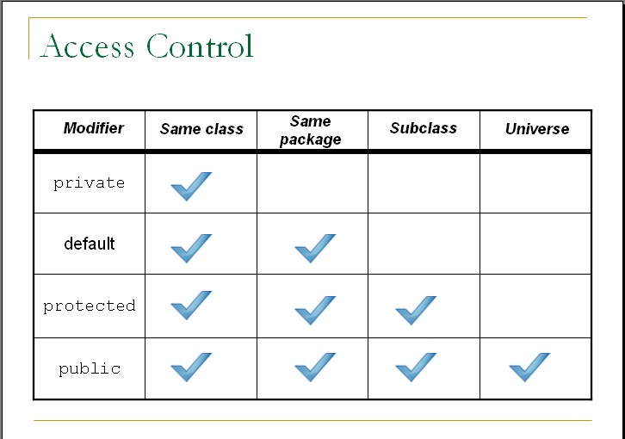
Access Control
Access Modifier | Same Class | Same Package | Sub Class | Universal
Private
Default
Protected
Public

Slide 45
Exercise
Why multiple and Hybrid inheritance is not supported in java.
Implement inheritance in java using following diagram.
Shape
#String name + String color
Shape()
Circle
~ radius: double ~PI: double
calCircleArea(): double
Rectangle
~height: double ~width: double
calRectArea(): double
Triangle
~length: double ~width: double
calTriArea(): double

Slide 46
Interview Questions
Which class in Java is superclass of every other class?
Can a class extend itself?
Can we assign superclass to subclass?
Can a class extend more than one class?

Slide 47
Polymorphism

Slide 48

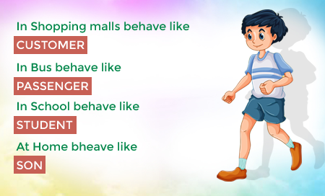



Polymorphism
Polymorphism: It is a Greek term means, “One name many Forms”
Polymorphism
Poly:
Many
Morphism:
Types
Most important concept of object oriented programming
In OOP, Polymorphism is the ability of an object to take on many forms.

Slide 49
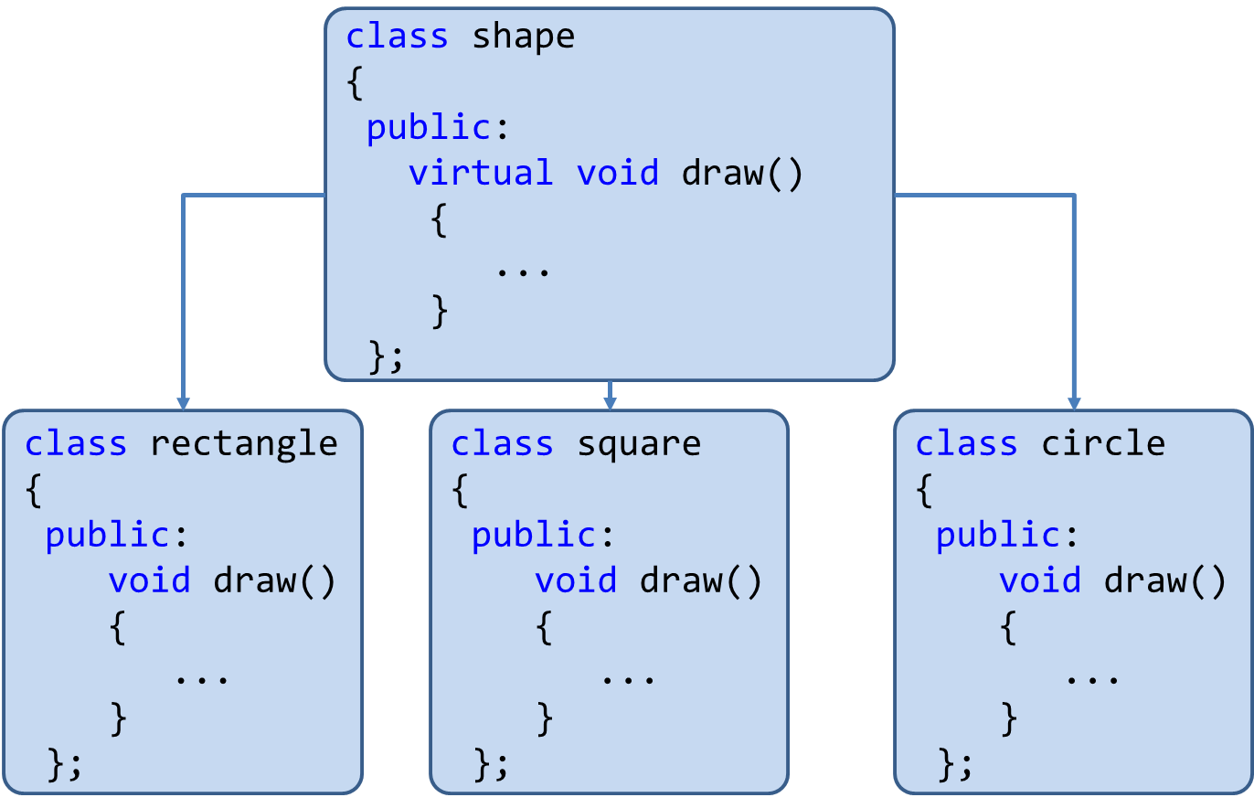
Polymorphism
Polymorphism is the method in an object-oriented programming language that does different things depending on the class of the object which calls it.
Polymorphism can be implemented using the concept of overloading and overriding.

Slide 50
Polymorphism: Advantages
Single variable can be used to store multiple data types.
Easy to debug the codes.
It allows to perform a single act in different ways.
Polymorphism allows the object to decide which form of the function to implement at compile-time (overloading) as well as run-time (overriding).
Reduces coupling, increases reusability and makes code easier to read.

Slide 51
Implementing Polymorphism
Polymorphism
Using
Method Overloading
Using
Method Overriding

Slide 52
Implementing Polymorphism
Overloading & Overrding

Slide 53
Implementing Polymorphism
Polymorphism
Using
Method Overloading
Using
Method Overriding

Slide 54
Method Overloading

Slide 55
Method Overloading: Compile-time Polymorphism
Definition: When two or more methods are implemented that share same name but different parameter(s), the methods are said to be overloaded, and the process is referred to as method overloading
Method overloading is one of the ways that Java implements polymorphism.
When an overloaded method is invoked, Java uses the type and/or number of arguments as its guide to determine which version of the overloaded method to actually call.
E.g. public void draw()
public void draw(int height, int width)
public void draw(int radius)
Thus, overloaded methods must differ in the type and/or number of their parameters.
While in overloaded methods with different return types and same name & parameter are not allowed ,as the return type alone is insufficient for the compiler to distinguish two versions of a method.

Slide 56
Method Overloading: Compile-time Polymorphism
class OverloadDemo{
public static void main(String[] args){
Addition a1= new Addition();
//call all versions of add()
a1.add(20);
a1.add(30,50);
a1.add(10,30,60);
}
}
class Addition{
int i,j,k;
void add(int a){
i=a;
System.out.println("add i="+i);
}
void add(int a,int b){\\overloaded add()
i=a;
j=b;
System.out.println("add i+j="+(i+j));
}
void add(int a,int b,int c){\\overloaded add()
i=a;
j=b;
k=c;
System.out.println("add i+j+k="+(i+j+k));
}
}
Output
add i=20
add i+j=80
add i+j+k=100

Slide 57
Method Overriding

Slide 58
Method Overriding: Run-time Polymorphism
In a class hierarchy, when a method in a subclass has the same name and type signature as a method in its superclass, then the method in the subclass is said to override the method in the superclass.
Definition: If subclass (child class) has the same method as declared in the parent class, it is known as method overriding in Java.

Slide 59
Method Overriding: OverrideDemo.java
class OverrideDemo{
public static void main(String[] args) {
Circle c= new Circle();
c.draw(); //child class meth()
Square sq= new Square();
sq.draw();//child class meth()
Shape sh= new Shape();
sh.draw();//parentClass meth()
}
}
class Shape{
void draw(){
System.out.println("Draw Shape");
}
}
class Circle extends Shape{
void draw(){
System.out.println("Draw Circle");
}
}
class Square extends Shape{
void draw(){
System.out.println("Draw Square");
}
}
When an overridden method is called from within a subclass, it will always refer to the version of that method defined by the subclass. The version of the method defined by the superclass will be hidden.
Output
Draw Circle
Draw Square
Draw Shape

Slide 60
Method Overriding: OverrideDemo.java
class OverrideDemo{
public static void main(String[] args) {
Circle c= new Circle();
c.draw();
Square sq= new Square();
sq.draw();
}
}
class Shape{
void draw(){
System.out.println("Draw Shape");
}
}
class Circle extends Shape{
void draw(){
System.out.println("Draw Circle");
}
}
class Square extends Shape{
void draw(){
System.out.println("Draw Square");
}
}
super.draw();
Here, super.draw( ) calls the superclass version of draw( ).
Output
Draw Shape
Draw Circle
Draw Square
Overridden methods in Java are similar to virtual functions in C++ and C#.

Slide 61
Why Overriding?
Method overriding is used to provide the specific implementation of a method which is already provided by its superclass.
Method overriding is used for runtime polymorphism.
By combining inheritance with overridden methods, a superclass can define the general form of the methods that will be used by all of its subclasses.
Dynamic, run-time polymorphism is one of the most powerful mechanisms that object-oriented design brings to bear on code reuse and robustness.

Slide 62
Method Overriding: Points to remember
Method overriding occurs only when the names and the type signatures of the two methods are identical. If they are not, then the two methods are simply overloaded.
The method must have the same name as in the parent class
The method must have the same parameter as in the parent class.
There must be an IS-A relationship (inheritance).

Slide 63
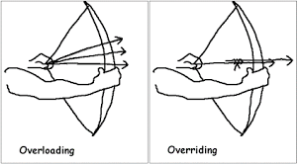
Overloading vs Overriding

Slide 64
Overloading vs Overriding: Java Methods
Method Overloading | Method Overriding
Overloading:Method with same name different signature | Overriding:Method with same name same signature
Inheritance and method hiding is not involved here. | Here subclass method hides the super class method.
It is performed within class. | It occurs in two classes with IS-A (inheritance) relationship.
Known as Compile-time Polymorphism | Known as Run-time Polymorphism

Slide 65
“final” keyword
The final keyword is used for restriction.
final keyword can be used in many context
Final can be:
Variable
If you make any variable as final, you cannot change the value of final variable(It will be constant).
Method
If you make any method as final, you cannot override it.
Class
If you make any class as final, you cannot extend it.

Slide 66
1) “final” as a variable
Can not change the value of final variable.
public class FinalDemo {
final int speedlimit=90;//final variable
void run(){
speedlimit=400;
}
public static void main(String args[]){
FinalDemo obj=new FinalDemo();
obj.run();
}
}
final

Slide 67
2) “final” as a method
If you make any method as final, you cannot override it.
class BikeClass{
final void run(){
System.out.println("Running Bike");
}
}
class Pulsar extends BikeClass{
void run(){
System.out.println("Running Pulsar");
}
public static void main(String args[]){
Pulsar p= new Pulsar();
p.run();
}
}
final

Slide 68
3) “final” as a Class
If you make any class as final, you cannot extend it.
final
final class BikeClass{
void run(){
System.out.println("Running Bike");
}
}
class Pulsar extends BikeClass
{
void run(){
System.out.println("Running Pulsar");
}
public static void main(String args[]){
Pulsar p= new Pulsar();
p.run();
}
}

Slide 69
Encapsulation

Slide 70
Encapsulation
Program
Encapsulation
Class
{
Data Members(e.g. int a=10)
+
Methods(e.g. add() )
}
Variables/Data Members
Class
The action of enclosing something in.
In OOP, encapsulation refers to the bundling of data with the methods.
Methods()

Slide 71
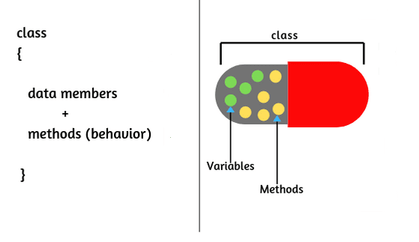
Encapsulation
The wrapping up of data and functions into a single unit is known as encapsulation
The insulation of the data from direct access by the program is called data hiding or information hiding.
It is the process of enclosing one or more details from outside world through access right.
Advantages
Protects an object from unwanted access
It reduces implementation errors.
Simplifies the maintenance of the application and makes the application easy to understand.
Protection of data from accidental corruption.

Slide 72
Abstraction

Slide 73


Abstraction
Data abstraction is also termed as information hiding.
Abstraction is the concept of object-oriented programming that “represents” only essential attributes and “hides” unnecessary information.
Abstraction is all about representing the simplified view and avoid complexity of the system.
It only shows the data which is relevant to the user.
In object-oriented programming, it can be implemented using Abstract Class.
Advantage:
It reduces programming complexity.
Example:
A car is viewed as a car rather than its
numerous individual components.

Slide 74
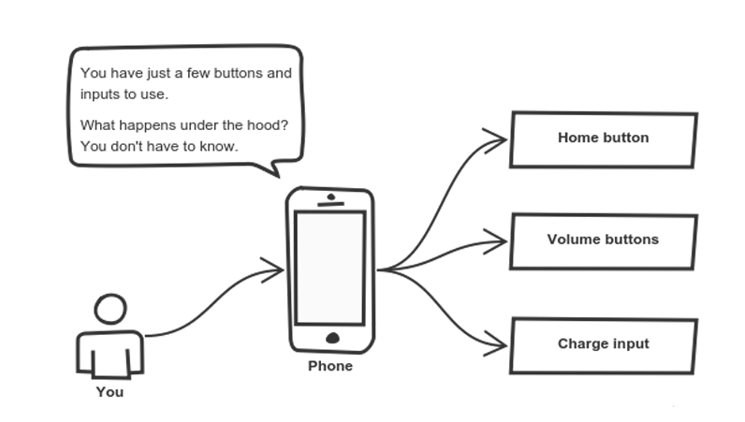
Abstraction

Slide 75
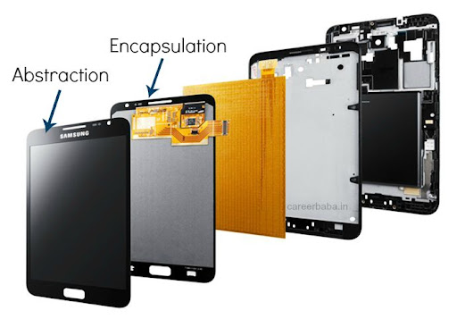
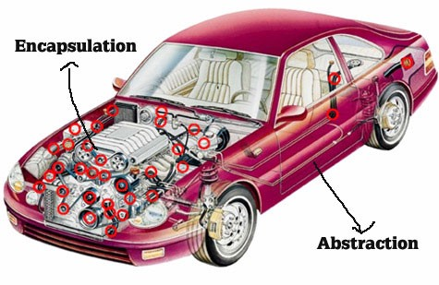
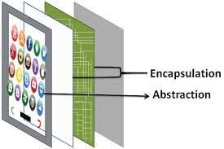
Abstraction vs. Encapsulation
Abstraction | Encapsulation
It means act of removing/ withdrawing something unnecessary. | It is act of binding code and data together and keep the data secure from outside interference.
Applied at Designing stage. | Applied at Implementation stage.
E.g. Interface and Abstract Class | E.g. Access Modifier (public, protected, private)
Purpose: Reduce code complexity | Purpose: Data protection

Slide 76
Implementing Abstraction
Part of Unit-6

Slide 77
Abstract class

Slide 78

Abstract class
Abstraction is a process of hiding the implementation details from the user, only the functionality will be provided to the user.
In other words, the user will have the information on what the object does instead of how the object will do it.
Abstraction is achieved using Abstract classes and interfaces.
A class which contains the abstract keyword in its declaration is known as abstract class.
Abstract classes may or may not contain abstract methods, i.e., methods without body ( public void get(); )
But, if a class has at least one abstract method, then the class must be declared abstract.
If a class is declared abstract, it cannot be instantiated.
To use an abstract class, we have to inherit it to another class and provide implementations of the abstract methods in it.

Slide 79
Abstract class (Example)
abstract class Car {
public abstract double getAverage();
}
class Swift extends Car{
public double getAverage(){
return 22.5;
}
}
class Baleno extends Car{
public double getAverage(){
return 23.2;
}
}
public class MyAbstractDemo{
public static void main(String ar[]){
Swift s = new Swift();
Baleno b = new Baleno();
System.out.println(s.getAverage());
System.out.println(b.getAverage());
}
}
Output
22.5
23.2

Slide 80
Why Abstract Class?
Sometimes, we need to define a superclass that declares the structure of a given abstraction without providing a complete implementation.
The superclass will only define a generalized form, that will be shared by all the subclasses.
The subclasses will fill the details of every method.
When a superclass is unable to create a meaningful implementation for a method.

Slide 81
Points to remember for Abstract Class
To declare a class abstract, you simply use the abstract keyword in front of the class keyword at the beginning of the class declaration.
There can be no objects of an abstract class. That is, an abstract class cannot be directly instantiated with the new operator. Such objects would be useless, because an abstract class is not fully defined.
Cannot declare abstract constructors, or abstract static methods.
Any subclass of an abstract class must either implement all of the abstract methods in the superclass, or be itself declared abstract.

Slide 82

Interface

Slide 83
Interface
An interface is similar to an abstract class with the following exceptions
All methods defined in an interface are abstract.
Interfaces doesn’t contain any logical implementation
Interfaces cannot contain instance variables. However, they can contain public static final variables (ie. constant class variables)
Interfaces are declared using the "interface" keyword
Interfaces are more abstract than abstract classes
Interfaces are implemented by classes using the "implements" keyword
Interfaces are syntactically similar to classes, but they lack instance variables, and their methods are declared without any body.

Slide 84
Interface:Syntax
public or not used(default)
access interface name
{
return-type method-name1(parameter-list);
return-type method-name2(parameter-list);
type final-varname1 = value;
type final-varname2 = value;
// ...
return-type method-nameN(parameter-list);
type final-varnameN = value;
}
Methods are without body(no implementation) and all methods are implicitly abstract.
implicitly final and static, cannot be changed by the implementing class, must
be initialized with a constant value.

Slide 85
Implementing Interfaces
Once an interface has been defined, one or more classes can implement that interface.
To implement an interface, include the implements clause in a class definition, and then create the methods defined by that interface.
access interface name
{
return-type method-name1(parameter-list);
type final-varname1 = value;
}
access class classname
[extends superclass]
[implements interface [,interface...]] {
// class-body
}

Slide 86
Interface (Example)
interface VehicleInterface {
int a = 10;
public void turnLeft();
public void turnRight();
public void accelerate();
public void slowDown();
}
class CarClass implements VehicleInterface
{
public void turnLeft() {
System.out.println("Left");
}
public void turnRight() {
System.out.println("Right");
}
public void accelerate() {
System.out.println("Speed");
}
public void slowDown() {
System.out.println(“Brake");
}
}
Here access specifier of method must be public
public class DemoInterface{
public static void main(String[] a)
{
CarClass c = new CarClass();
c.turnLeft();
}
}
Variable in interface are by default
public, static, final
We have to provide implementation to all the methods of the interface
Output
Left

Slide 87
Interface (Example)
interface VehicleInterface {
int a = 10;
public void turnLeft();
public void turnRight();
public void accelerate();
public void slowDown();
}
class CarClass implements VehicleInterface
{
public void turnLeft() {
System.out.println("Left");
}
public void turnRight() {
System.out.println("Right");
}
public void accelerate() {
System.out.println("Speed");
}
public void slowDown() {
System.out.println(“Brake");
}
}
public class DemoInterface{
public static void main(String[] a)
{
c = new CarClass();
c.turnLeft();
}
}
VehicleInterface
CarClass
variable c is declared to be of the interface type VehicleInterface, yet it was
assigned an instance of CarClass.
Output
Left

Slide 88
Interface: Partial Implementations
If a class includes an interface but does not fully implement the methods defined by that interface, then that class must be declared as abstract.
interface VehicleInterface {
int a = 10;
public void turnLeft();
public void turnRight();
public void accelerate();
public void slowDown();
}
abstract
class CarClass implements VehicleInterface
{
public void turnLeft() {
System.out.println("Left");
}
public void turnRight() {
System.out.println("Right");
}
}
public class DemoInterface{
public static void main(String[] a)
{
CarClass c = new CarClass();
c.turnLeft();
}
}
Either class need to implement all the methods of Interface or declare that class as abstract if partial implementation is required.
public void accelerate() {
System.out.println("Speed");
}
public void slowDown() {
System.out.println(“Brake");
}

Slide 89
Interface:Example
class CreateStack implements StackIntf{
int mystack[];
int tos;
CreateStack(int size){
mystack= new int[size];
tos=-1;
}
public void push(int p){
if(tos==mystack.length-1){
System.out.println("StackOverflow");
}
else{
mystack[++tos]=p;
}
}
public int pop(){
if(tos<0){
System.out.println("StackUnderflow");
return 0;
}
else return mystack[tos--];
}
}
interface StackIntf{
public void
push(int p);
public int pop();
}
StackDemo.java

Slide 90
Interface:Example StackDemo.java
class StackDemo{
public static void main(String[] args) {
CreateStack cs1= new CreateStack(5);
CreateStack cs2= new CreateStack(8);
for(int i=0;i<5;i++)
cs1.push(i);
for(int i=0;i<8;i++)
cs2.push(i);
System.out.println("MyStack1=");
for(int i=0;i<5;i++)
System.out.println(cs1.pop());
System.out.println("MyStack2=");
for(int i=0;i<8;i++)
System.out.println(cs2.pop());
}
}

Slide 91
Interfaces Can Be Extended
One interface can inherit another by use of the keyword extends.
The syntax is the same as for inheriting classes.
When a class implements an interface that inherits another interface, it must provide implementations for all methods defined within the interface inheritance chain.

Slide 92
InterfaceHierarchy.java
class MyClass1 implements B{
public void method1(){
System.out.println("inside MyClass1:method1()");}
public void method2(){
System.out.println("inside MyClass1:method2()");
}
public void method3(){
System.out.println("inside MyClass1:method3()");
}
}
interface A{
void method1();
void method2();
}
interface B extends A{
void method3();
}
interface C extends A{
void method4();
}
class InterfaceHierarchy{
public static void main
(String[] args) {
MyClass1 c1=new MyClass1();
MyClass2 c2=new MyClass2();
c1.method1();
c1.method2();
c1.method3();
c2.method1();
c2.method2();
c2.method4();
}
}
class MyClass2 implements C{
public void method1(){
System.out.println("inside MyClass2:method1()");}
public void method2(){
System.out.println("inside MyClass2:method2()");
}
public void method4(){
System.out.println("inside MyClass2:method4()");
}
}

Slide 93
Interface: Points to Remember
Any number of classes can implement an interface.
One class can implement any number of interfaces.
To implement an interface, a class must create the complete set of methods defined by the interface. However, each class is free to determine the details of its own implementation.

Slide 94
Abstract class vs. Interface
Abstract class | Interface
Abstract class doesn't support multiple inheritance. | Interface supports multiple inheritance.
Abstract class can have abstract and non-abstract methods. | Interface can have only abstract methods.
Abstract class can have final, non-final, static and non-static variables. | Interface has only static and final variables.
An abstract class can extend another Java class and implement multiple Java interfaces. | An interface can extend another Java interface only.
A Java abstract class can have class members like private, protected, etc. | Members of a Java interface are public by default.

Slide 95
Abstraction vs. Encapsulation

Slide 96
Advantages of Object-Oriented Programming

Slide 97
Advantages of Object-Oriented Programming
Security
Upgrade-able
Flexibility
High-quality Software
Reusability
Easy Partition
Maintenance
Portability

Slide 98
instanceof operator
instanceof Operator
Syntax:
( Object reference variable ) instanceof (class/interface type)
Example:
boolean result = name instanceof String;

Slide 99
Wrapper classes
A Wrapper class is a class whose object wraps or contains a primitive datatypes.
When we create an object to a wrapper class, it contains a field and in this field, we can store a primitive datatypes.
In other words, we can wrap a primitive value into a wrapper class object.
Use of wrapper class :
They convert primitive datatypes into objects.
The classes in java.util package handles only objects and hence wrapper classes help in this case also.
Data structures in the Collection framework, such as ArrayList and Vector, store only objects (reference types) and not primitive types.
An object is needed to support synchronization in multithreading.

Slide 100
Wrapper classes (Cont.)
Primitive datatype | Wrapper class | Example
byte | Byte | Byte b = new Byte((byte) 10);
short | Short | Short s = new Short((short) 10);
int | Integer | Integer i = new Integer(10);
long | Long | Long l = new Long(10);
float | Float | Float f = new Float(10.0);
double | Double | Double d = new Double(10.2);
char | Character | Character c = new Character('a');
boolean | Boolean | Boolean b = new Boolean(true);
Common Fields (Except Boolean):
MIN_VALUE : will return the minimum value it can store.
MAX_VALUE : will return the maximum value it can store.

Slide 101
Parsing the String
Using wrapper class we can parse string to any primitive datatype (Except char).
byte b1 = Byte.parseByte("10");
short s = Short.parseShort("10");
int i = Integer.parseInt("10");
long l = Long.parseLong("10");
float f = Float.parseFloat("10.5");
double d = Double.parseDouble("10.5");
boolean b2 = Boolean.parseBoolean("true");
char c = Character.parseCharacter('a');
Note : for Integer class we have parseInt not parseInteger

Slide 102
BigInteger and BigDecimal
The BigInteger class found in java.math package is used for mathematical operation which involves very big integer calculations that are outside the limit of all available primitive data types.
For example factorial of 100 contains 158 digits in it so we can’t store it in any primitive data type available.
There is no theoretical limit on the upper bound of the range because memory is allocated dynamically
The BigDecimal class found in java.math package provides operation for arithmetic, comparison, hashing, rounding, manipulation and format conversion.
This method can handle very small and very big floating point numbers with great precision.
import java.math.BigInteger;
public class DemoBigNumbers {
public static void main(String[] args) {
BigInteger bi = new BigInteger("1234567891234567891234567890");
System.out.println(bi); // will return 1234567891234567891234567890
}
}
BigDecimal bd = new BigDecimal("111111.000000000000000000025");
System.out.println(bd); //111111.000000000000000000025

Slide 103
String Class
An object of the String class represents a string of characters.
The String class belongs to the java.lang package, which does not require an import statement.
Like other classes, String has constructors and methods.
String class has two operators, + and += (used for concatenation).
Empty String :
An empty String has no characters. It’s length is 0.
Not the same as an uninitialized String.
String word1 = "";
String word2 = new String();
Empty strings
String word1;
This is null

Slide 104
String Initialization
Copy constructor creates a copy of an existing String.
Copy Constructor: Each variable points to a different copy of the String.
String word = new String("Java");
String word2 = new String(word);
word
"Java"
word2
"Java"
Assignment: Both variables point to the same String.
String word = "Java";
String word2 = word;
word
"Java"
word2

Slide 105
String Immutability
Advantage
Disadvantage
Convenient — Immutable objects are convenient because several references can point to the same object safely.
Less efficient — you need to create a new string and throw away the old one even for small changes.
String name="DIET - Rajkot";
foo(name);
//Some operations on String name
name.substring(7,13);
bar(name);
/* we will be sure that the value of name will be same for foo() as well as bar() as String is immutable its value will be same for both the functions.
*/
String word = "java";
char ch =
Character.toUpperCase(
word.charAt (0));
word = ch + word.substring (1);
word
"java"
"Java"

Slide 106
String Methods — length, charAt
int length();
Returns the number of characters in the string
Returns:
"Problem".length();
7
int charAt(i);
Returns the char at position i.
Character positions in strings starts from 0 – just like arrays.
Returns:
"Window".charAt (2);
'n'

Slide 107
String Methods — substring
We can obtain a portion of a string by use of substring(), It has two forms
String subs = word.substring (i, k);
returns the substring of chars in positions from i to k-1
String subs = word.substring (i);
returns the substring from the i-th char to the end
television
i k
immutable
i
Returns:
"television".substring(2,5);
"immutable".substring(2);
"rajkot".substring(9);
“lev"
“mutable"
"" (empty string)

Slide 108
String Methods — Concatenation
public class ConcatenationExample{
public static void main(String[] args) {
String word1 = "re";
String word2 = "think";
String word3 = "ing";
int num = 2;
String result = word1 + word2;
// concatenates word1 and word2 "rethink"
result = word1.concat(word2);
// the same as word1 + word2 "rethink"
result += word3;
// concatenates word3 to result "rethinking"
result += num;
// converts num to String & joins it to result "rethinking2"
}
}

Slide 109
String Methods — Find (indexOf)
String name = " ";
name.indexOf ('P');
name.indexOf ('e');
name.indexOf ("Minister");
name.indexOf ('e', 8);
name.indexOf (“xyz");
name.lastIndexOf ('e');
P | r | i | m | e |  | M | i | n | i | s | t | e | r
0 | 1 | 2 | 3 | 4 | 5 | 6 | 7 | 8 | 9 | 10 | 11 | 12 | 13
0
4
6
12
(starts searching at position 8)
-1
(not found)
18

Slide 110
String Methods — Equality
boolean b = word1.equals(word2);
returns true if the string word1 is equal to word2
boolean b = word1.equalsIgnoreCase(word2);
returns true if the string word1 matches word2, ignoring the case of the string.
b = "Raiders".equals("Raiders"); // will return true
b = "Raiders".equals("raiders"); // will return false
b = "Raiders".equalsIgnoreCase("raiders"); // will return true

Slide 111
String Methods — Comparisons
int diff = word1.compareTo(word2);
returns the “difference” word1 - word2
int diff = word1.compareToIgnoreCase(word2);
returns the “difference” word1 - word2, ignoring the case of the strings
Usually programmers don’t care what the numerical “difference” of word1 - word2 is, what matters is if
the difference is negative (word1 less than word2),
zero (word1 and word2 are equal)
or positive (word1 grater than word2).
Often used in conditional statements.
if(word1.compareTo(word2) > 0){
//word1 grater than word2…
}

Slide 112
Comparison Examples
//negative differences
diff = "apple".compareTo("berry"); // a less than b
diff = "Zebra".compareTo("apple"); // Z less than a
diff = "dig".compareTo("dug"); // i less than u
diff = "dig".compareTo("digs"); // dig is shorter
//zero differences
diff = "apple".compareTo("apple"); // equal
diff = "dig".compareToIgnoreCase("DIG"); // equal
//positive differences
diff = "berry".compareTo("apple"); // b grater than a
diff = "apple".compareTo("Apple"); // a grater than A
diff = "BIT".compareTo("BIG"); // T grater than G
diff = "application".compareTo("app"); // application is longer

Slide 113
String Methods — trim & replace
trim() method
replace() method
String word2 = word1.trim();
returns a new string formed from word1 by removing white space at both ends,
it does not affect whites space in the middle.
String word2 = word1.replace(oldCh, newCh);
returns a new string formed from word1 by replacing all occurrences of oldCh with newCh
String word1 = " Hello From Darshan ";
String word2 = word1.trim();
// word2 is "Hello From Darshan"
// no spaces on either end
String word1 = "late";
String word2 = word1.replace('l', 'h');
System.out.println(word2);
//Output : "hate"
String str1 = "Hello World";
String str2 = str1.replace("World","Everyone");
System.out.println(str2);
// Output : "Hello Everyone"

Slide 114
String Methods — Changing Case
String word2 = word1.toUpperCase();
returns a new string formed from word1 by converting its characters to upper case
String word3 = word1.toLowerCase();
returns a new string formed from word1 by converting its characters to lower case
String word1 = "HeLLo";
String word2 = word1.toUpperCase(); // "HELLO"
String word3 = word1.toLowerCase(); // "hello"

Slide 115
StringBuffer
The java.lang.StringBuffer class is a thread-safe, mutable sequence of characters.
Following are the important points about StringBuffer:
A string buffer is like a String, but can be modified (mutable).
It contains some particular sequence of characters, but the length and content of the sequence can be changed through certain method calls.
They are safe for use by multiple threads.
StringBuffer Constructors
S.N | Constructor & Description
1 | StringBuffer() This constructs a string buffer with no characters in it and an initial capacity of 16 characters.
2 | StringBuffer(CharSequence seq) This constructs a string buffer that contains the same characters as the specified CharSequence.
3 | StringBuffer(int capacity) This constructs a string buffer with no characters in it and the specified initial capacity.
4 | StringBuffer(String str) This constructs a string buffer initialized to the contents of the specified string.

Slide 116
StringBuffer Methods
Remember : “StringBuffer” is mutable
As StringBuffer class is mutable we need not to replace the reference with a new reference as we have to do it with String class.
Method | description
append(String s) | is used to append the specified string with this string.
insert(int offset, String s) | is used to insert the specified string with this string at the specified position.
replace(int startIndex, int endIndex, String str) | is used to replace the string from specified startIndex and endIndex.
delete(int startIndex, int endIndex) | is used to delete the string from specified startIndex and endIndex.
reverse() | is used to reverse the string.
StringBuffer str1 = new StringBuffer("Hello Everyone");
str1.reverse();
// as it is mutable can not write str1 = str1.reverse();
// it will change to value of the string itself
System.out.println(str1);
// Output will be “enoyrevE olleH”

Slide 117
String Builder
Java StringBuilder class is used to create mutable string.
The Java StringBuilder class is same as StringBuffer class except that it is non-synchronized.
It is available since JDK 1.5.
It has similar methods as StringBuffer like append, insert, reverse etc…

Slide 118
ArrayList
The java.util.ArrayList class provides resizable-array and implements the List interface.
Following are the important points about ArrayList:
It implements all optional list operations and it also permits all elements, including null.
It provides methods to manipulate the size of the array that is used internally to store the list.
ArrayList (constructors) :
S.N. | Constructor & Description
1 | ArrayList() This constructor is used to create an empty list with an initial capacity sufficient to hold 10 elements.
2 | ArrayList(Collection<? extends E> c) This constructor is used to create a list containing the elements of the specified collection.
3 | ArrayList(int initialCapacity) This constructor is used to create an empty list with an initial capacity.

Slide 119
ArrayList (method)
S.N. | Method & Description
1 | void add(int index, E element) This method inserts the specified element at the specified position in this list.
2 | boolean addAll(Collection<? extends E> c) This method appends all of the elements in the specified collection to the end of this list, in the order that they are returned by the specified collection's Iterator
3 | void clear() This method removes all of the elements from this list.
4 | boolean contains(Object o) This method returns true if this list contains the specified element.
5 | E get(int index) This method returns the element at the specified position in this list.
6 | int indexOf(Object o) This method returns the index of the first occurrence of the specified element in this list, or -1 if this list does not contain the element.

Slide 120
ArrayList (method) (cont.)
S.N. | Method & Description
7 | boolean isEmpty() This method returns true if this list contains no elements.
8 | int lastIndexOf(Object o) This method returns the index of the last occurrence of the specified element in this list, or -1 if this list does not contain the element.
9 | boolean remove(Object o) This method removes the first occurrence of the specified element from this list, if it is present.
10 | E set(int index, E element) This method replaces the element at the specified position in this list with the specified element.
11 | int size() This method returns the number of elements in this list.
12 | Object[] toArray() This method returns an array containing all of the elements in this list in proper sequence (from first to last element).

Slide 121
Thank You

